Slide 1
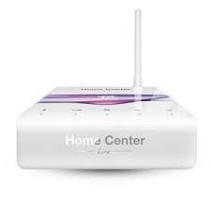
HOW TO ADD LILIN CAMERAS TO FIBARO PROJECTS
LILIN Australia

Slide 2
Click on Devices on TOP and then Click on Add or Remove Device on the LEFT
LILIN Australia

Slide 3
Click on the Add tab to add camera
LILIN Australia

Slide 4
Give the Camera a Name, Select Other Model, and type login details as per image above and then SAVE
LILIN Australia

Slide 5
Type Camera IP Address and then fill in all URL scripts just cut and past from table on next slide. And then SAVE
LILIN Australia

Slide 6
Cut and Paste URL strings into the appropriate line as above slide for camera commands Fibaro Marketplace Web link: https://marketplace.fibaro.com/site?page=11
COMMANDS | URL STRINGS
Default User | admin
Default Password | pass
TCP port | 80
JPG path | Snap1vga
MJPG stream path | getimage?camera=2&fmt=vga&delay=200
Turn left URL | control?rpan=-20&stop=1&camid=2
Turn right URL | control?rpan=20&stop=1&camid=2
Move up URL | control?rtilt=20&stop=1&camid=2
Move Down URL | control?rtilt=-20&stop=1&camid=2
Zoom IN URL | control?rzoom=-20&stop=1&camid=2
Zoom Out URL | control?rzoom=20&stop=1&camid=2
Stop Camera Movement URL | control?home=1&stop=1&camid=2
LILIN Australia

